Slide 1

Adaptive Multi-Dimensional Trust-Based Federated Learning Framework for Explainable IoT Intrusion Detection
Department of Computer Science and Engineering
Project Phase – I Review
project guide
Dr.n.pazhaniraja
Associate professor
Department of cse
TEAM MEMBERS(CSE III-A)
Thirumurugan T(23UCS160)
Jerald Sanjay A(23UCS073)
Pradipkumar S(23UCS118)
T Prince Kevin(23UCS161)

Slide 2
AGENDA
ABSTRACT
OBJECTIVES
INTRODUCTION
LITERATURE SURVEY
EXISTING SYSTEM
PROPOSED SYSTEM
SYSTEM ARCHITECTURE
MODULES
REFERENCES

Slide 3
ABSTRACT
The increasing number of IoT devices has created significant security and privacy challenges for intrusion detection systems. Traditional centralized IDS approaches require network data to be transferred to a central server, which may expose sensitive information. Federated Learning enables collaborative intrusion detection by allowing clients to train models locally without sharing raw data. However, unreliable or compromised clients may submit abnormal or malicious model updates, and unreliable causal information may affect the trustworthiness of explanations. This project proposes an Adaptive Multi-Dimensional Trust-Based Federated Learning Framework that evaluates client contributions using multiple trust parameters including gradient consistency, majority similarity, historical reliability, anomaly score, causal reliability, and behavioral stability. Trust information is used for both model aggregation and causal-summary aggregation, producing a more robust global IDS model and reliable global causal explanations.

Slide 4
INTRODUCTION
Cyber Security
Cyber Security protects computer networks, devices, applications, and data from unauthorized access and cyber attacks.
IoT environments increase security challenges because of their large number of connected and distributed devices.
Intrusion Detection Systems monitor network traffic to identify suspicious or malicious activities.
IoT Intrusion Detection
IoT networks generate large volumes of heterogeneous network traffic.
Attacks such as DoS, probing, botnets, and unauthorized access can compromise IoT environments.
Machine learning can be used to identify abnormal network behavior.

Slide 5
INTRODUCTION
Federated Learning
Federated Learning enables multiple clients to collaboratively train a machine learning model.
Clients keep their raw network data locally and share model updates instead.
A central server aggregates client contributions to build a global model.
Explainable AI
Traditional machine learning IDS models may provide predictions without clearly explaining them.
Causal reasoning can identify important relationships between network features and intrusion outcomes.
A global causal graph can provide interpretable information about intrusion predictions.
Our Project Aim
To create a secure Global Explainable IDS for the IoT systems .

Slide 6
OBJECTIVES
To develop a privacy-preserving federated learning framework for IoT intrusion detection.
To evaluate the reliability of participating clients using an Adaptive Multi-Dimensional Trust Engine.
To analyze client contributions using Gradient Consistency, Majority Similarity, Historical Reliability, Anomaly Score, Causal Reliability, and Behavioral Stability.
To integrate causal reasoning for generating interpretable explanations of intrusion predictions.

Slide 7
LITERATURE REVIEW
S.No | Paper Title | Author(s) & Publication | Theme | Advantage | Disadvantage
1 | Explainable Federated Learning through Causal Reasoning for Intrusion Detection in IoT | F. Asiri, Discover Internet of Things, 2026 | Causal Federated IDS | Provides privacy-preserving and explainable IoT intrusion detection | Robustness against advanced poisoning attacks requires further investigation
2 | FLTrust: Byzantine-Robust Federated Learning via Trust Bootstrapping | Cao et al., NDSS, 2021 | Trust-based FL aggregation | Reduces influence of malicious client updates | Mainly focuses on model-update trust
3 | The Limitations of Federated Learning in Sybil Settings | Fung et al., RAID, 2020 | Sybil-resistant FL | Uses client similarity to reduce coordinated malicious influence | Does not address causal explanations
4 | Machine Learning with Adversaries: Byzantine Tolerant Gradient Descent | Blanchard et al., NeurIPS, 2017 | Byzantine-robust aggregation | Provides robustness against Byzantine workers | Does not incorporate causal information

Slide 8
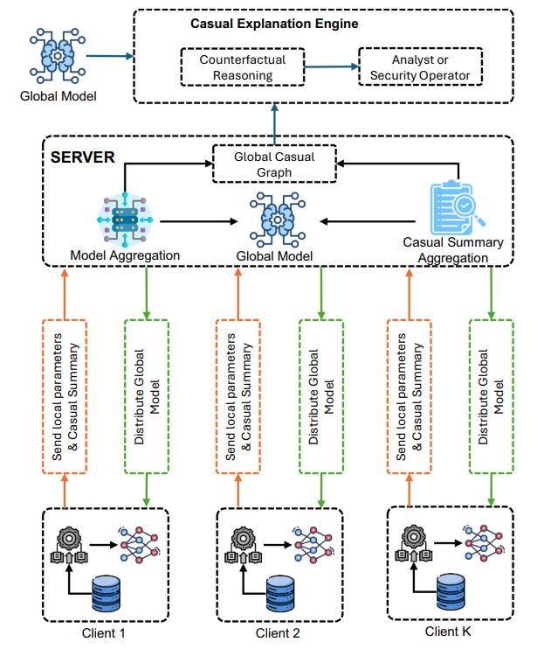
EXISTING SYSTEM

Slide 9
EXISTING SYSTEM
Federated Intrusion Detection
Multiple IoT clients train intrusion detection models locally. Clients send model updates to a central federated server.
The server aggregates client updates to create a global IDS model. Raw network data remains at the individual clients.
Causal Explainable Federated IDS
Clients perform local causal discovery. Causal information is represented using causal summaries.
The server aggregates causal information from multiple clients. A global causal graph is constructed for explainable intrusion detection.
Existing Limitation
Client contributions require stronger investigation of reliability and robustness, particularly under unreliable or adversarial participation

Slide 10
PROPOSED SYSTEM
The proposed system extends the existing explainable federated IDS by introducing an Adaptive Multi-Dimensional Trust Engine.
Key Features
Federated IDS: Local training without sharing raw network data.
Causal Discovery: Generates causal summaries from local client data.
Adaptive Trust Engine: Evaluates the reliability of each client before aggregation.
Multi-Dimensional Trust: Uses six trust parameters:
  i) Gradient Consistency iv) Anomaly Score
  ii) Causal Reliability v) Behavioral Stability
  iii) Majority Similarity vi) Historical Reliability
Trust-Based Model Aggregation: Controls the influence of client model updates.
Trust-Based Causal Aggregation: Controls the influence of client causal summaries.

Slide 11
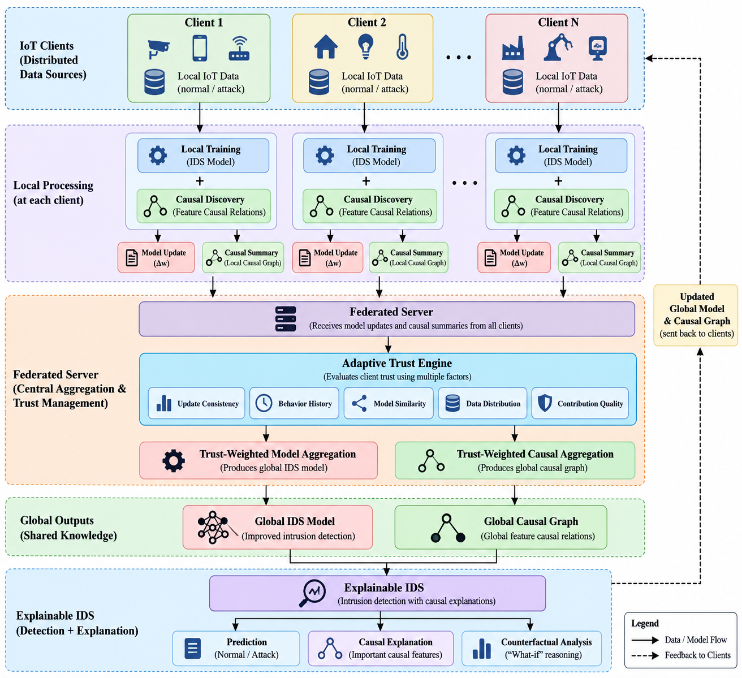
SYSTEM ARCHITECTURE

Slide 12
MODULES
1. Federated Client Module
Divides the IoT intrusion dataset into multiple simulated clients.
Performs local preprocessing and IDS model training.
Keeps client data locally and Generates model updates for the federated server.
2. Local Causal Discovery Module
Analyses relationships between network features and intrusion outcomes. Generates local causal information.
Produces a compact causal summary. Sends the causal summary instead of raw local data.
3. Adaptive Trust Engine
Evaluates client reliability during each federated round.
Calculates six trust dimensions. Maintains client trust history across rounds.
Generates an overall trust value for aggregation.

Slide 13
MODULES
4. Trust-Based Model Aggregation
Receives model updates from participating clients. Uses client trust values to determine contribution weights.
Reduces the influence of suspicious or unreliable updates. Generates the global IDS model.
5. Trust-Based Causal Aggregation
Receives causal summaries from clients. Evaluates causal reliability along with overall client trust.
Aggregates reliable causal information.
Generates the global causal graph.
6. Explainable Intrusion Detection
Uses the global IDS model to classify network activity.
Uses the global causal graph to support interpretation and Provides an explanation for detected intrusion patterns.
Enables analysis of the factors contributing to the prediction.

Slide 14
REFERENCES
[1] F. Asiri, “Explainable federated learning through causal reasoning for intrusion detection in IoT,” Discover Internet of Things, vol. 6, Art. no. 23, 2026.
[2] Y. Xiao, “Adaptive trust evaluation and representation-based robust aggregation against poisoning attacks in federated learning,” Scientific Reports, vol. 16, Art. no. 19800, 2026.
[3] D. Javeed, M. S. Saeed, M. Adil, P. Kumar, and A. Jolfaei, “A federated learning-based zero trust intrusion detection system for Internet of Things,” Ad Hoc Networks, vol. 162, Art. no. 103540, 2024.
[4] T. T. Thein, Y. Shiraishi, and M. Morii, “Personalized federated learning-based intrusion detection system: Poisoning attack and defense,” Future Generation Computer Systems, vol. 153, pp. 182–192, 2024.
[5] P. Ruzafa-Alcazar et al., “Intrusion detection based on privacy-preserving federated learning for the industrial IoT,” IEEE Transactions on Industrial Informatics, 2023.

